Slide 1
Introduction of Mobile Development for .NET Developers
Alejandro Ruiz
Microsoft MVP: Developer Technologies
@alejandroruizva
https://alejandroruizvarela.com
alejandro@alejandroruizvarela.com
Notes:
Who has mobile device? iOS, Android
Who has moved from one to the other?
Experience is the same on both, apps exist in both places

Slide 2


Slide 3
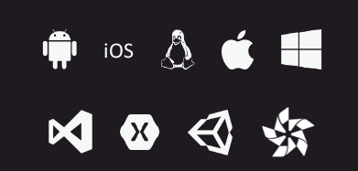
.NET any developer, any app, any platform

Slide 4
Architecting Mobile Apps

Slide 5
Architecting Mobile Apps

Slide 6

Silo approach
iOS
Android
Windows
Objective-C/Swift
Xcode
Java/Kotlin
Android Studio
C#
Visual Studio
No shared code • Many languages and development environments • Multiple teams
Notes:
Vendor specific way - tools from Apple/Google/MS
Means you build 3 apps
Need 3x developers
Lack of feature parity if apps built different speeds (lack of iOS devs may slow down iOS)
Fixes/improvements on multiple platforms
Advantage - latest and greatest, everything

Slide 7
Write once, run anywhere
Lua
Javascript
Actionscript
HTML+CSS
App generator
Limited native API access • Slow performance • Poor user experience
Notes:
Write once, so fast to develop
Feature parity across all platforms
HTML/JS, so slow and poor UX
No specific API access to device features

Slide 8
Xamarin’s unique approach
iOS C# UI
Android C# UI
Windows C# UI
Shared C# logic
Shared C# codebase • 100% native API access • High performance
Notes:
Native, but in shared language
Thin Wrappers around native SDKs – UIViewController. Activity
As fast as native, feature parity easy, 70% shared code

Slide 9
Xamarin’s unique approach
iOS F# UI
Android F# UI
Shared F# logic
Shared F# codebase • 100% native API access • High performance
Notes:
F# is also supported
Don Syme, language inventor on secondment to Xaamrin

Slide 10
Native User Interfaces
Native API Access
Native Performance
Notes:
Xamarin is Totally native
Controls/API/Performance

Slide 11



Xamarin Native—Traditional UI
iOS C#
Android C#
Windows C#
Shared C# Logic
3 Native User Interfaces
Shared App Logic
Notes:
Storyboards and Android XML
SAME as on native
Recources can be copied from native apps

Slide 12
How Xamarin Works

Slide 13
Windows APIs
Microsoft.Phone
Microsoft.Networking
Windows.Storage
Windows.Foundation
Microsoft.Devices
System.Net
System
System.IO
System.Linq
System.Xml
System.Data
System.Windows
System.Numerics
System.Core
System.ServiceModel
C#
Notes:
Same as silverlight/wpf/asp.net etc.
Can share code using system libs
Platform stuff is different

Slide 14
iOS—100% API coverage
MapKit
UIKit
iBeacon
CoreGraphics
CoreMotion
System.Net
System
System.IO
System.Linq
System.Xml
System.Data
System.Windows
System.Numerics
System.Core
System.ServiceModel
C#
Notes:
System.whatever ported to iOS
iOS APIs as platform APIs

Slide 15
Android—100% API coverage
Text-to-speech
ActionBar
Printing Framework
Renderscript
NFC
System.Net
System
System.IO
System.Linq
System.Xml
System.Data
System.Windows
System.Numerics
System.Core
System.ServiceModel
C#
Notes:
Android API as platform APIs

Slide 16
Xamarin app
iOS C# UI
Android C# UI
Windows C# UI
Shared C# logic
Notes:
Shared code runs on all platforms
Can be IL, so a class library

Slide 17
Native performance
ARM BINARY
IL + JIT
.NET
.NET
AOT
.APP
Compile and Link
.APK
C#
C#
Runs natively
Runs natively
Bindings
Bindings
Xamarin.iOS does full Ahead Of Time (AOT) compilation to produce an ARM binary for Apple’s App Store.
Xamarin.Android takes advantage of Just In Time (JIT) compilation on the Android device.
Notes:
Not JS running in a browser like other cross-plat frameworks
Native
Android AOT available as well to speed startup time
For iOS – you MUST have a Mac, Apple rules.
Android - used Android SDK

Slide 18
✓ Always up-to-date
Same-day support:
iOS 5
iOS 6
iOS 7
iOS 8
iOS 9
iOS 10
iOS 11
iOS 12
Full support for:
Apple Watch
Apple TV
Android Wear
Amazon Fire TV
Google Glass
and much more
Notes:
iOS – bound APIs few days after first preview
Full release on or before release day
Android – bit slower as release dates are not so announced
No-one can upgrade anyway.
Prod just after it rolls out to first set of phones

Slide 19
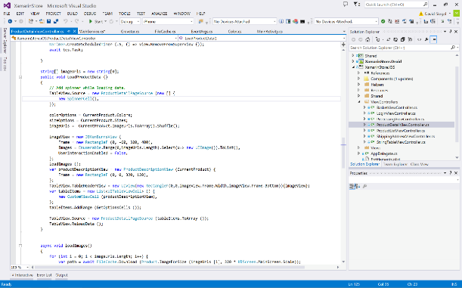
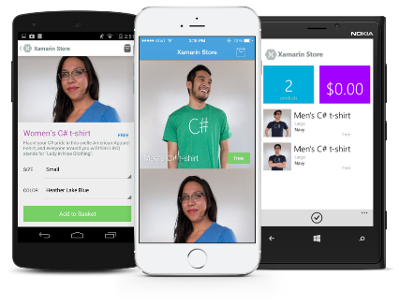
Anything you can do in Objective-C, Swift, or Java can be done in C# with Xamarin
Notes:
Apps, extensions, watch apps, tv apps…
No need to wait for phonegap plugins
Use all the things

Slide 20
Sharing User Interface
Notes:
70% reuse is great, but need more
But we still want native

Slide 21

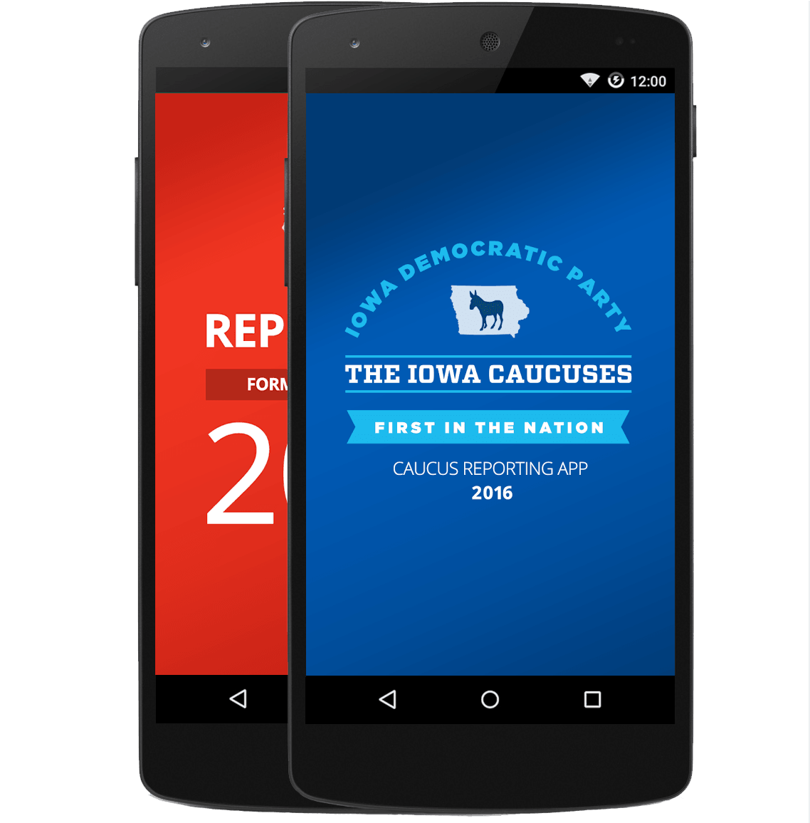
Xamarin.Forms—Cross Platform UI
Shared UI Code
Shared C# Logic
Shared Native User Interface
Shared App Logic
Notes:
Forms – originally designed for fast forms over data
Now powerful cross platform toolkit
Native – just an abstraction

Slide 22
Xamarin + Xamarin.Forms
iOS C# UI
Android C# UI
Windows C# UI
Xamarin.Forms
Shared C# Logic
Shared C# Logic
Traditional Xamarin approach
With Xamarin.Forms: More code-sharing, all native
Notes:
Up to 90-95% code sharing

Slide 23
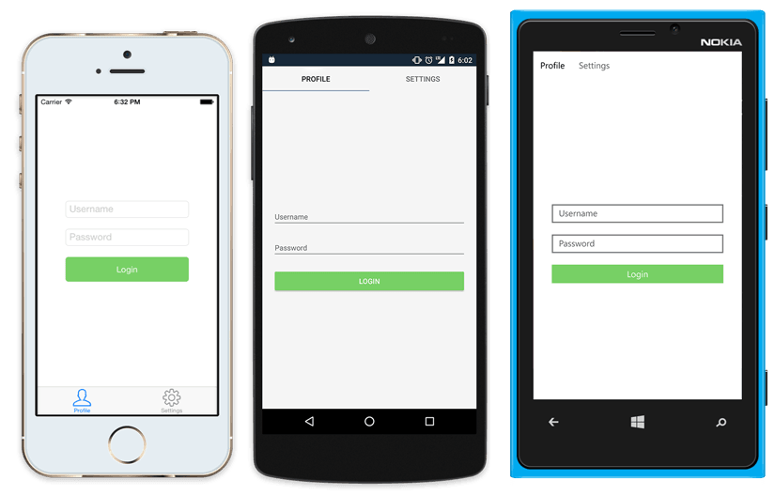
Native UI from shared code
<?xml version="1.0" encoding="UTF-8"?>
<TabbedPage xmlns="http://xamarin.com/schemas/2014/forms"
xmlns:x="http://schemas.microsoft.com/winfx/2009/xaml"
x:Class="MyApp.MainPage">
<TabbedPage.Children>
<ContentPage Title="Profile" Icon="Profile.png">
<StackLayout Spacing="20" Padding="20"
VerticalOptions="Center">
<Entry Placeholder="Username"
Text="{Binding Username}"/>
<Entry Placeholder="Password"
Text="{Binding Password}"
IsPassword="true"/>
<Button Text="Login" TextColor="White"
BackgroundColor="#77D065"
Command="{Binding LoginCommand}"/>
</StackLayout>
</ContentPage>
<ContentPage Title="Settings" Icon="Settings.png">
<!-- Settings -->
</ContentPage>
</TabbedPage.Children>
</TabbedPage>
Notes:
Native API access
Effects
Custom renderers

Slide 24
What’s included
✓ 40+ Pages, layouts, and controls
(Build from code behind or XAML)
✓ Two-way data binding
✓ Navigation
✓ Animation API
✓ Dependency Service
✓ Messaging Center
Shared UI Code
Shared C# Logic
Notes:
Pages, controls, navigation
Lowest common denominator, so just what is on all platforms
Full native API access – custom renderers, effects so can do everything

Slide 25
Demo
Github Code https://github.com/AlejandroRuiz/MonkeyFestGdl2018
Notes:
Demo Forms & Live Player

Slide 26
Xamarin Platform is
part of Visual Studio
Notes:
All versions, not an extra thing
Just click Xamain workload on VS 2017 to install it
Automatic on Mac

Slide 27


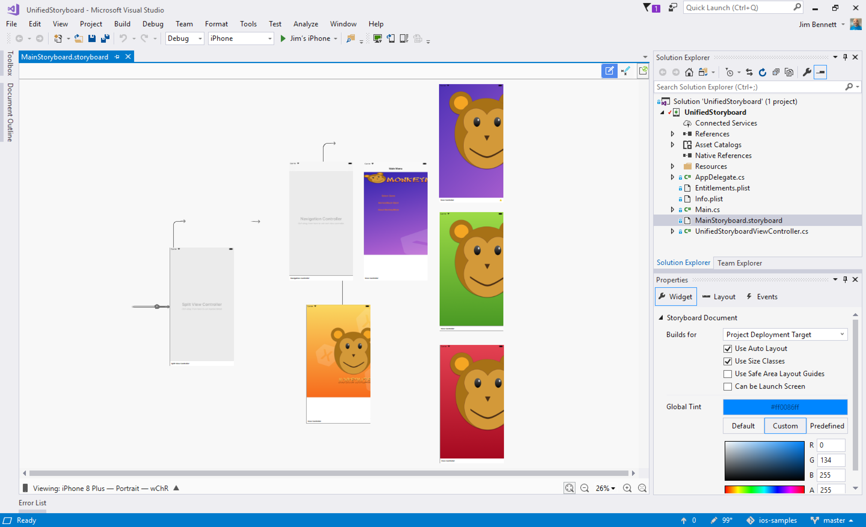
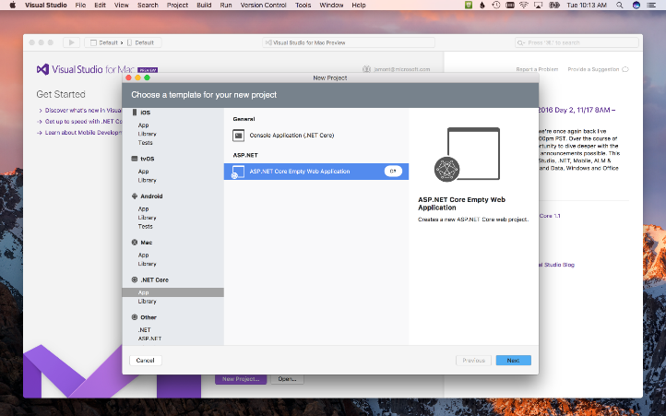
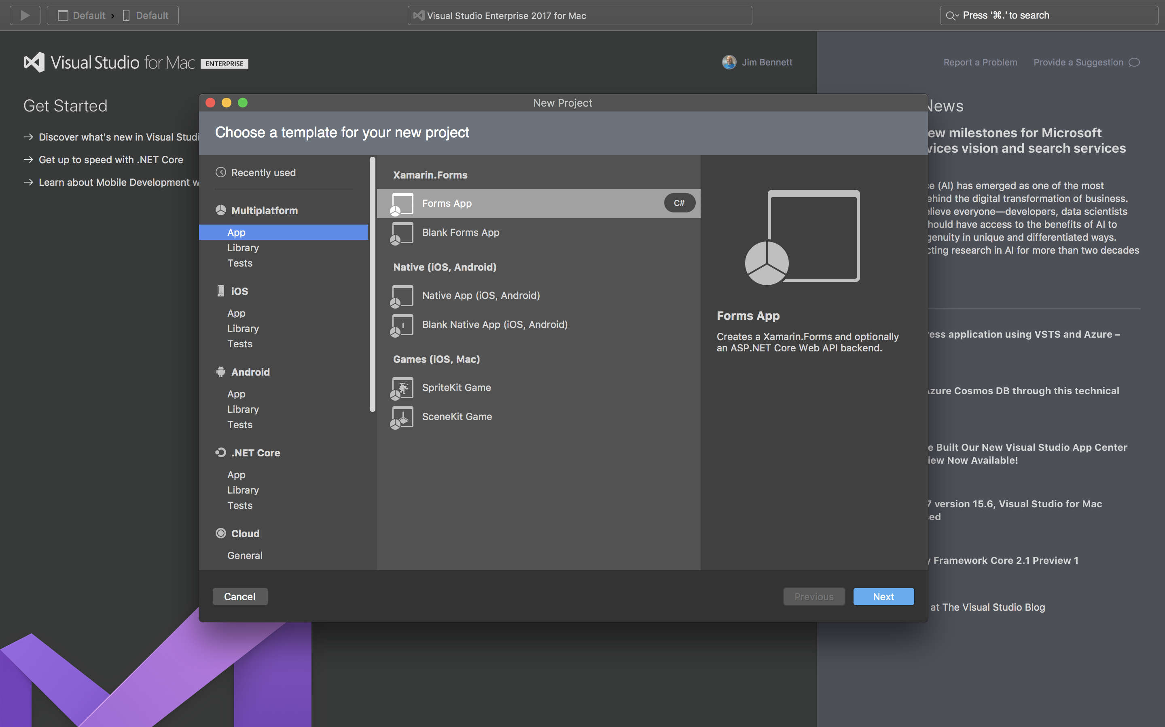
Visual Studio
Visual Studio for Mac
Notes:
Yup – VS on Mac
Any developer, any platform

Slide 28

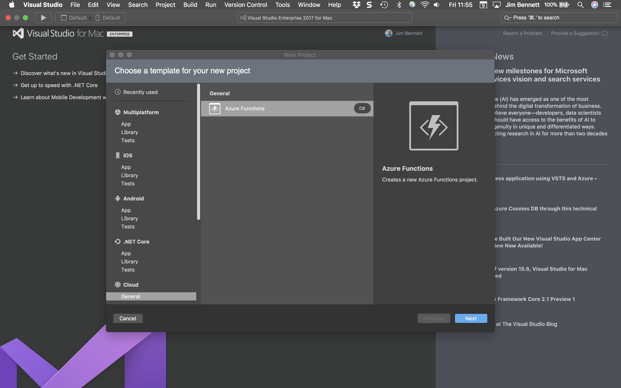
Visual Studio for Mac
iOS, Android, & macOS
.NET development
.NET Core & ASP.NET Core
Docker
Unity
Tools for Azure
Azure Functions
Included with your Visual Studio subscription at no additional cost
Free Community Edition
Notes:
Originally built from Xam Studio so mobile first
.NET core/ASP/Docker/Azure all there
Growing well – not as much stuff as Win
For most devs - perfect

Slide 29


Xamarin Ecosystem

Slide 30
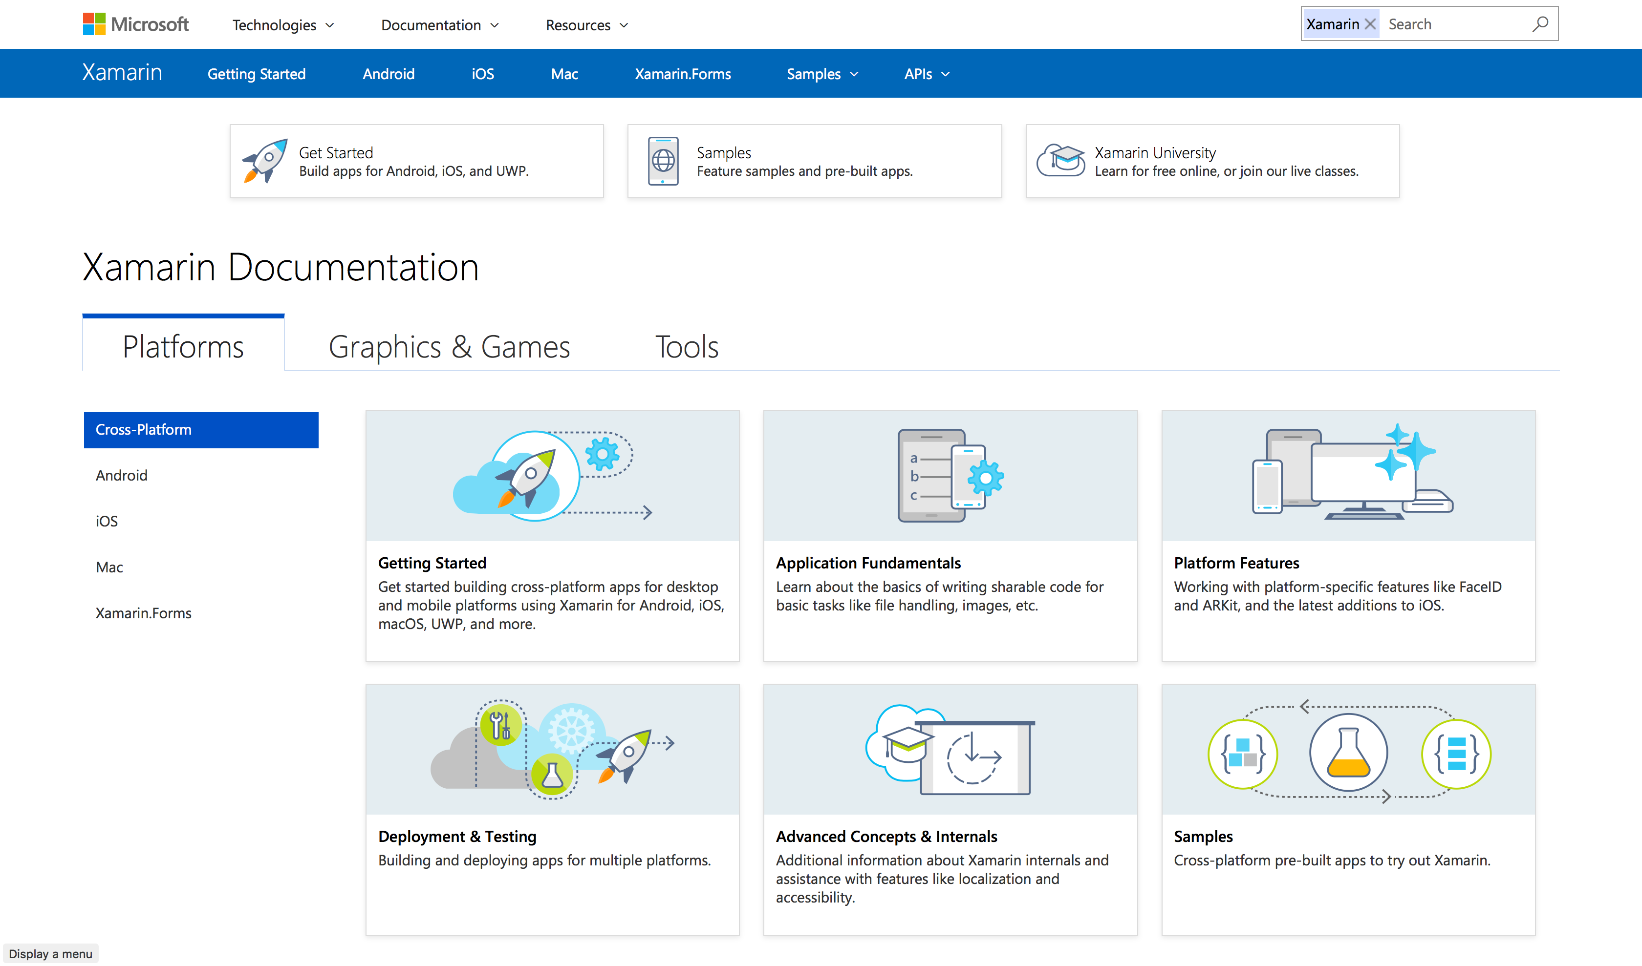
Xamarin docs

Slide 31


Free self-guided courses
Take free self-guided courses that cover the core Xamarin concepts and count towards certification.
Register at: university.xamarin.com/self-guided
Get a full subscription for live classes, advanced topics, and to complete certification.
Sign up at: xamarin.com/university
Notes:
Best way to learn – free videos
Paid for instructors
Certification, actually valued by employers
Great ecosystem of books

Slide 32

Alejandro Ruiz
Microsoft MVP: Developer Technologies
@alejandroruizva
https://alejandroruizvarela.com
alejandro@alejandroruizvarela.com
Getting started with Xamarin docs.microsoft.com/Xamarin
Xamarin University university.xamarin.com
Demo
https://github.com/AlejandroRuiz/MonkeyFestGdl2018

